Slide 1



Network Analysis Methods for studying microbial communities : A mini review
An in-depth peer review of the Network Analysis Methods by :
Daniel Agyapong
da2343@nau.edu
1st year PhD student
Dr. Toby Hocking
Toby.Hocking@nau.edu
Machine Learning Director

Slide 2
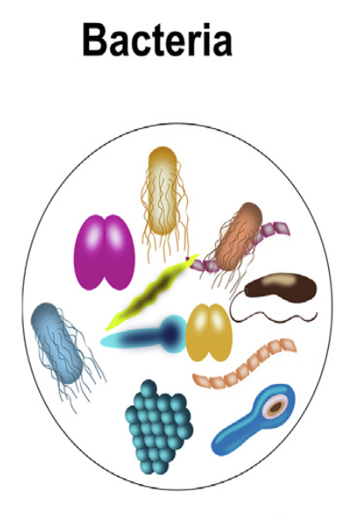
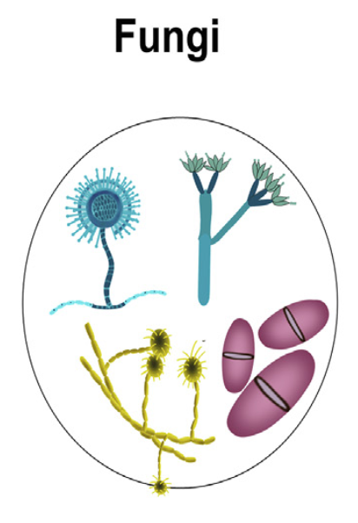
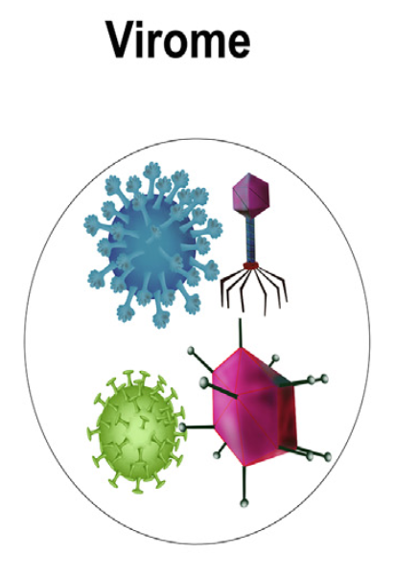
BACKGROUND
Microbial communities consist of micro-organisms such as bacteria, virus and fungi.
Micro-organisms have built robust ecosystems in various environments such as soil, sea water and various human organs.
Extensive research has been done on interactions between host and its microbiome.
These studies have revealed several cases of complex dynamics including trans-kingdom interactions between these micro-organisms and their effects on the host.
Network-based analytical approaches have helped in the study of systems with complex microbial interactions.

Slide 3

BACKGROUND
The microbes that live in humans
Ref: https://www.youtube.com/watch?v=c_ZRZkU-FEw

Slide 4
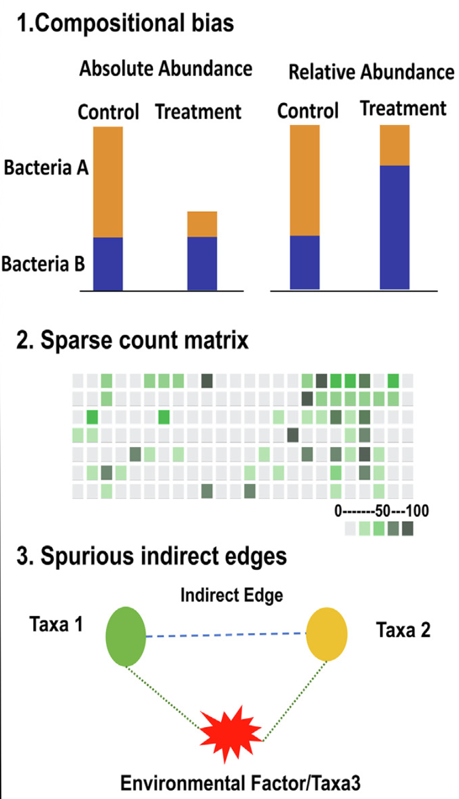
METHODOLOGY
The literature gives an overview of simple correlation and complex conditional dependence-based methods used to infer intra-kingdom interactions.
There are also various network-based methods for trans-kingdom analysis.
For simplicity of usage, there are also many packages in various programming languages like R and Python that replicate the functionality of these methods.
Decoding complex microbial co-occurrence relationships is associated with three main challenges.

Slide 5
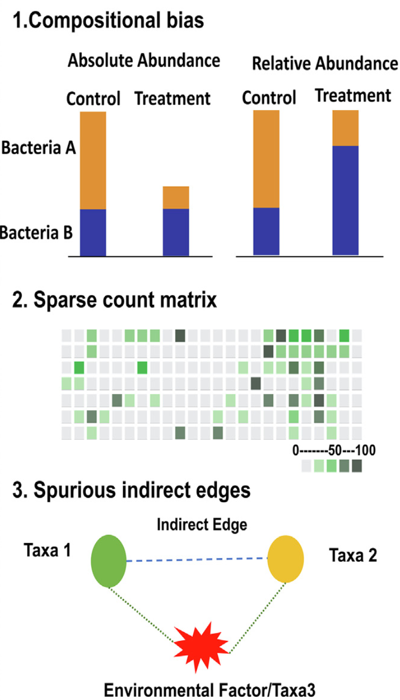
METHODOLOGY
The literature gives an overview of simple correlation and complex conditional dependence-based methods used to infer intra-kingdom interactions.
There are also various network-based methods for trans-kingdom analysis.
For simplicity of usage, there are also many packages in various programming languages like R and Python that replicate the functionality of these methods.
Decoding complex microbial co-occurrence relationships is associated with three main challenges.

Slide 6
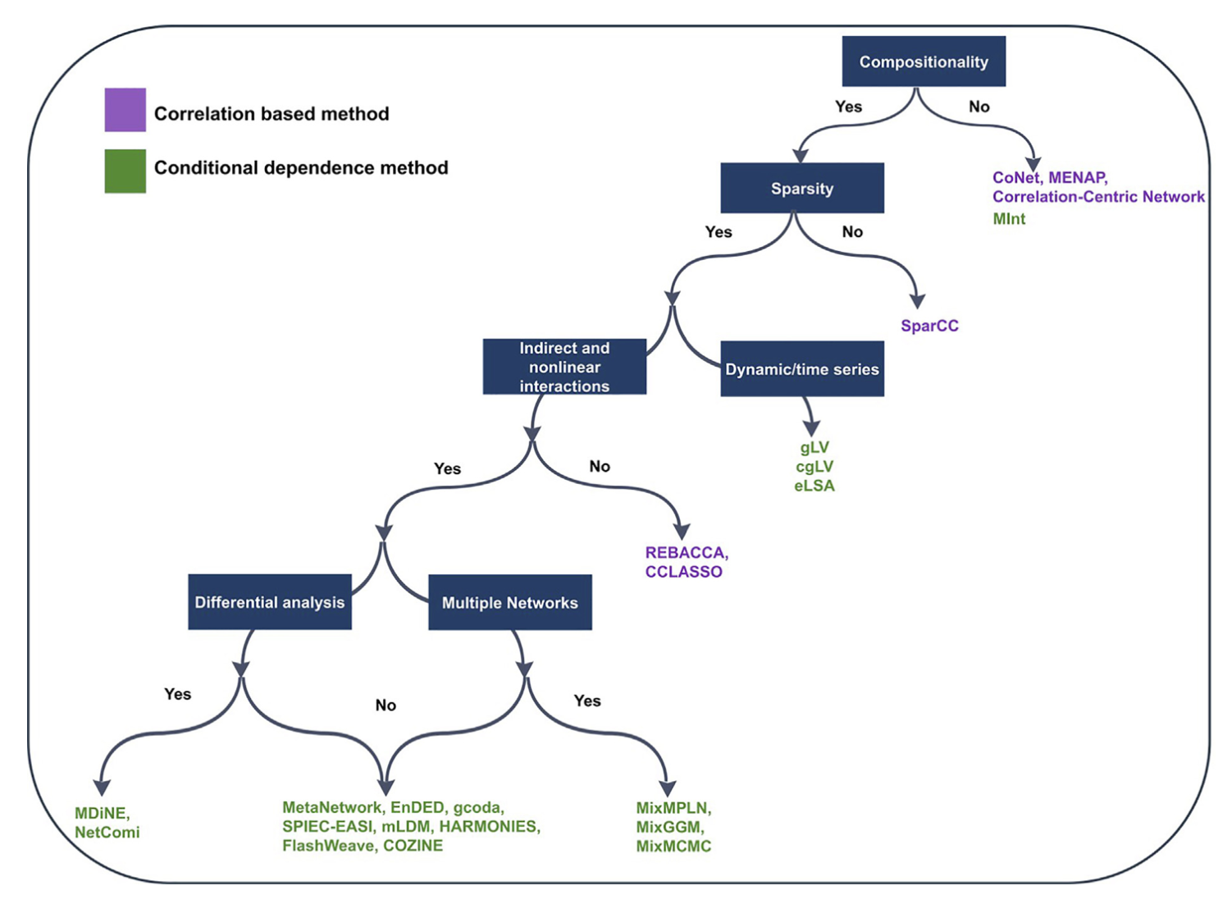
Workflow indicating the suitable network approaches depending on different challenges

Slide 7
Correlation Based Methods
Tools/Packages | Principle
SparCC (2012) https://rdrr.io/github/zdk123/SpiecEasi/man/sparcc.html | Pearson correlations via Bayesian framework
CCLasso (2015) https://github.com/huayingfang/CCLasso | Latent variable model with l1- norm shrinkage method
REBACCA (2015) https://faculty.wcas.northwestern.edu/hji403/REBACCA.htm | Linear system using pairwise log ratios
CoNet (2016) Cytoscape Command line tool https://github.com/ramellose/CoNetinR | Bray and Curtis, Kullback–Leibler dissimilarity measures, Pearson and Spearman correlation, and mutual information
Meta-Network (2019) https://github.com/guido-s/netmeta | Hybrid method with Pearson Cor- relation and graph-based method FS-Weight method to study indirect relationships

Slide 8
Conditional Dependence Methods
Tools/Packages | Principles/Models
gCoda (2017) https://github.com/huayingfang/gCoda | Logistic normal distribution Majorization-Minimization algorithm
NetComi (2020) R package https://github.com/stefpeschel/NetCoMi | Integrates extensive methods that take into account the special characteristics of amplicon data.
SPIEC-EASI (2015) R package https://github.com/zdk123/SpiecEasi | Graphical models using selecting neighborhoods or inverse covariance
MDiNE (2019) R package https://github.com/kevinmcgregor/mdine | Hierarchical Bayesian model
MixMPLN (2019) R package https://github.com/sahatava/MixMPLN | Mixture of multivariate Poisson lognormal distribution
Mint (2015) R package https://cran.r-project.org/web/packages/MInt | Poisson-multivariate normal hierarchical model
mLDM (2016) R package https://github.com/tinglab/mLDM | Lognormal-Dirichlet Multinomial hierarchical model
HARMONIES (2020) R package https://github.com/shuangj00/HARMONIES | Zero-inflated negative binomial distribution with Dirichlet process prior
COZINE R package (2020) https://github.com/MinJinHa/COZINE | Multivariate Gaussian Hurdle model

Slide 9
References
https://www.liebertpub.com/doi/10.1089/cmb.2021.0406

